Slide 1

Placement Project -02
Cardio Vascular Disease Prediction
Submitted by
Sangamesh S B

Slide 2
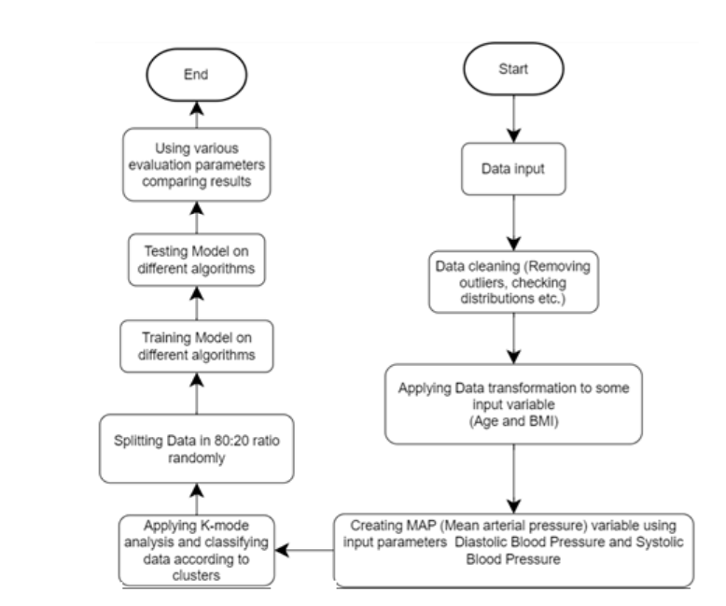
Agenda:
Problem statement
Importing the libraries and the dataset
Understand the data
Data Visualization
Univariate and bivariate analysis
Data Preprocessing
Handling missing data
Encoding Categorical Columns
Feature selection
Balancing Datapoints
Standardization
Model Building
Model Selection
Conclusion And further Recommendation

Slide 3
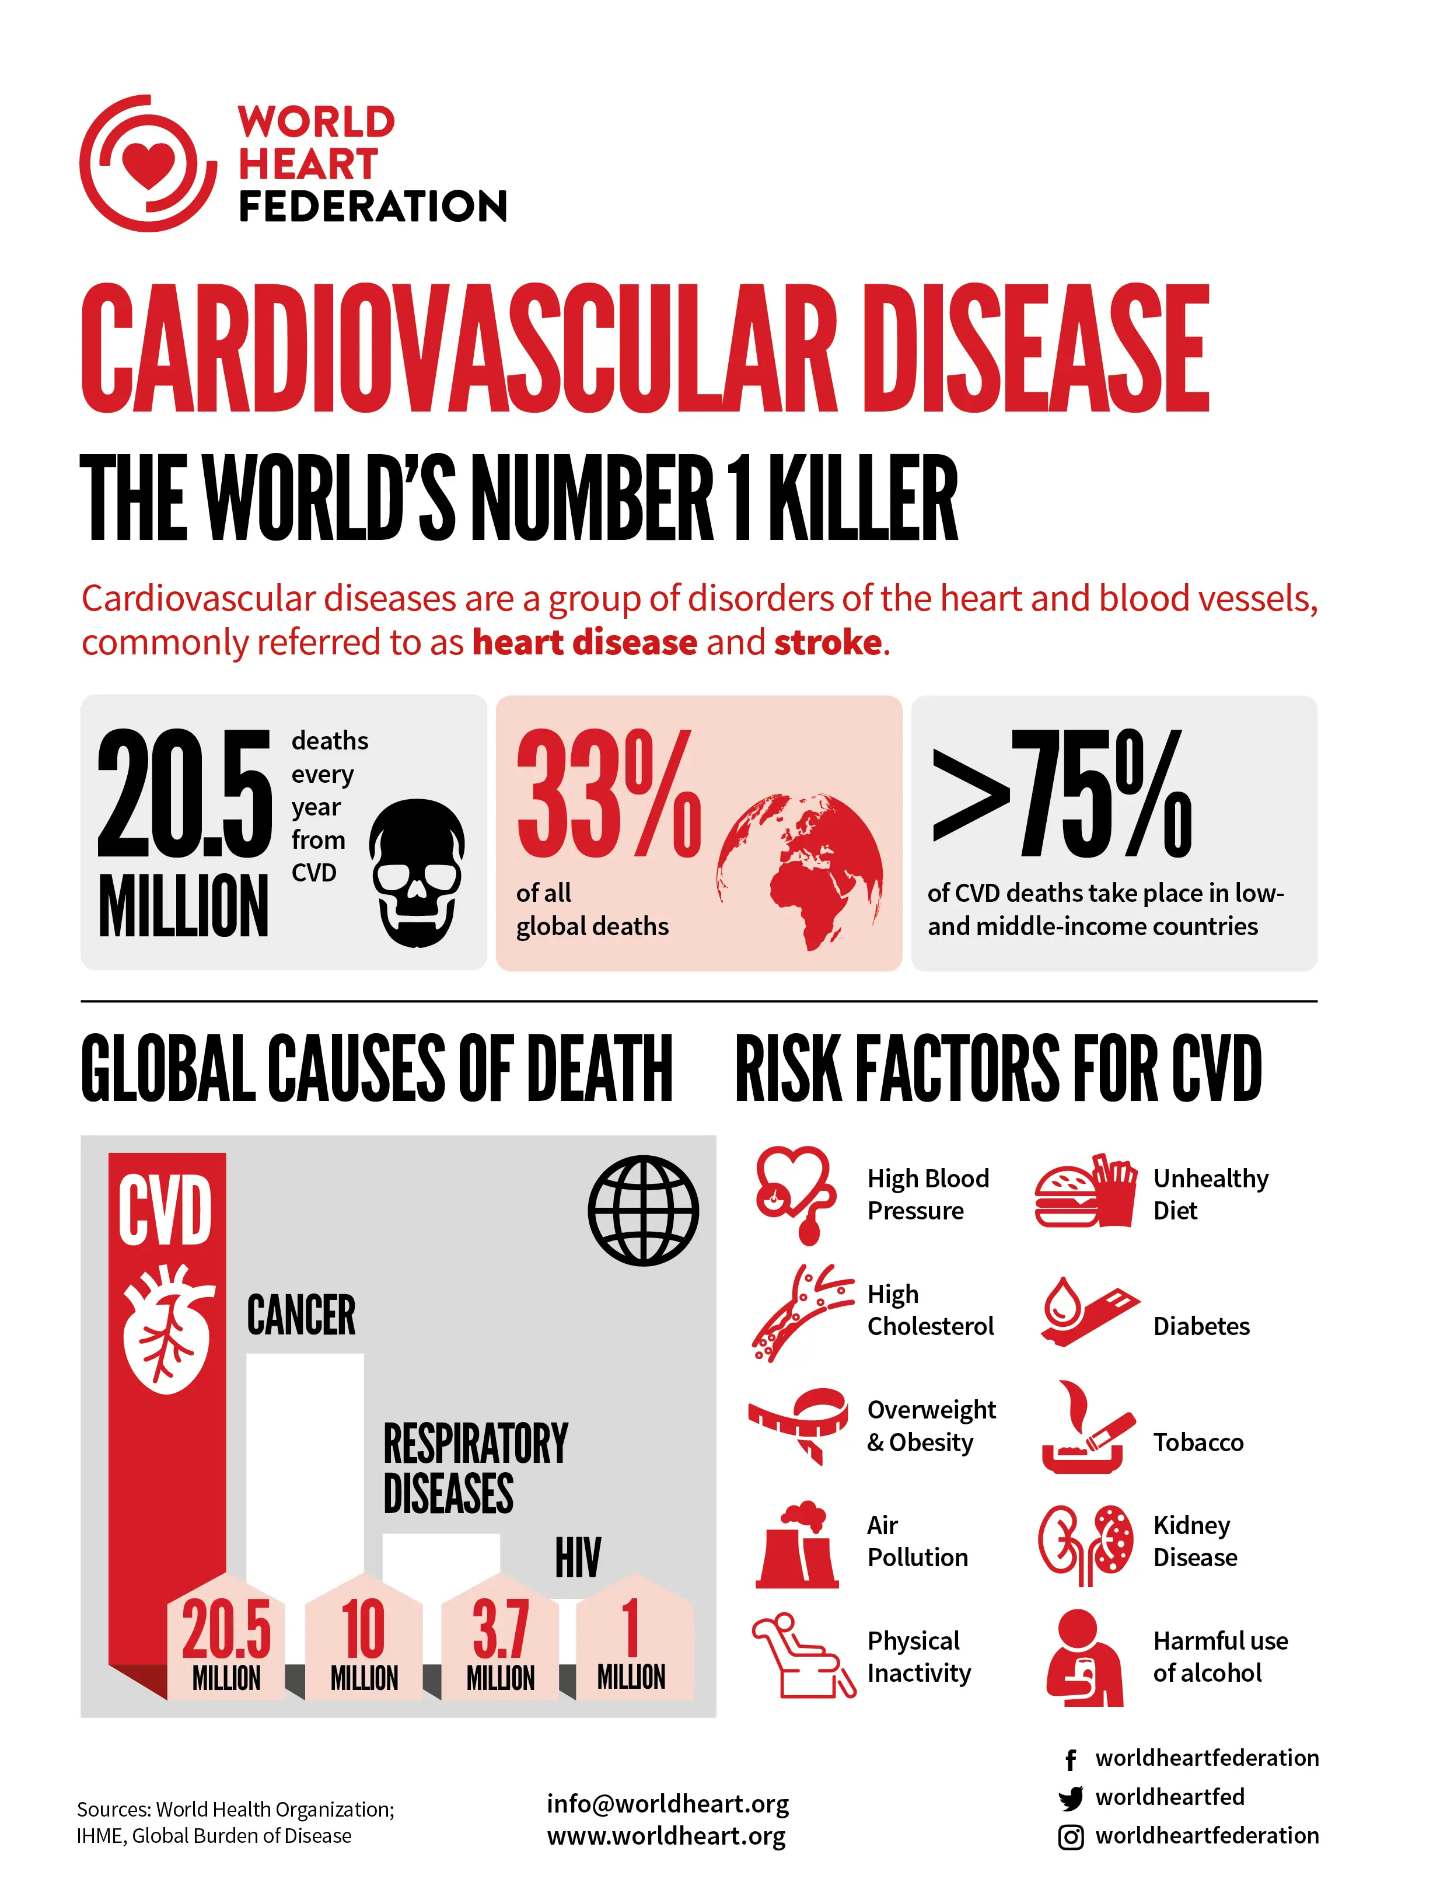
Abstract:
Cardiovascular diseases (CVDs) remain a significant global health concern, responsible for a substantial number of fatalities worldwide.
According to the World Heart Federation(WHF), Cardiovascular Disease (CVD) is the world’s number one killer.
Global Deaths: 20.5 million deaths annually due to CVD, Accounting for 33% of all global deaths
While there is no definitive cure for CVDs, early risk prediction and proactive measures—such as lifestyle adjustments, regular check-ups, and appropriate medications—can mitigate severe symptoms and improve overall outcomes.

Slide 4

Problem statement:
The dataset is from an ongoing cardiovascular study on residents of Framingham, Massachusetts.
The classification goal is to predict whether the patient has a 10-year risk of future coronary heart disease (CHD)
The dataset provides the patients’ information. It includes over 3390 records and 16 attribute Variables. Each attribute is a potential risk factor. There are both demographic, behavioral, and medical risk factors

Slide 5

Data Summary:
Demographic
Sex
Age
Education
Current Medical Status
Total cholesterol
Systolic BP
Diastolic BP
BMI
Heart rate
Glucose
Behavioral
Is _smoking
Cigarettes per day
Medical History
BP medication
Prevalent stroke
Prevalent hypertension
Diabetes
Ten Year risk of CHD

Slide 6
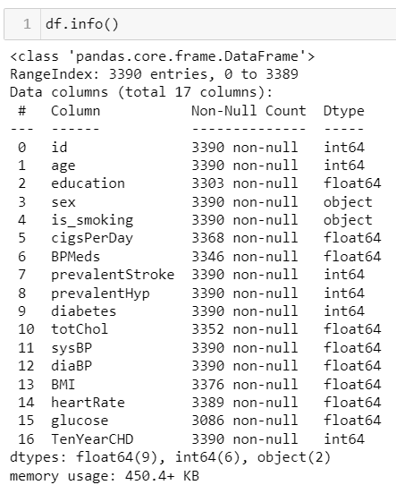
Exploratory Data Analysis:
Continuous Numerical Feature
age
cigsPerDay
totChol
sysBP
Categorical Features
Education
Sex
Is_smoking
BPMeds
diaBP
BMI
heartrate
glucose
Diabetes
prevalentStroke

Slide 7
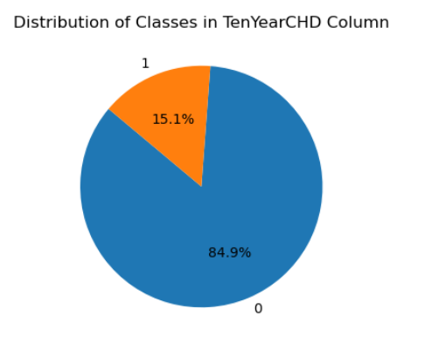
EDA(Data Visualization):
Dependent Variable exhibits class imbalance with 84.9% of 0 class and 15.1% of 1 class
majority of the data belongs to 0 category and 1 category remains the minority.
This problem would lead to the bad performance of the model due to the over-representation of the 0 data and it might lead to bias towards 0

Slide 8
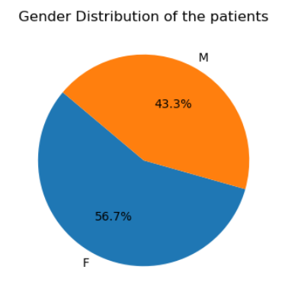
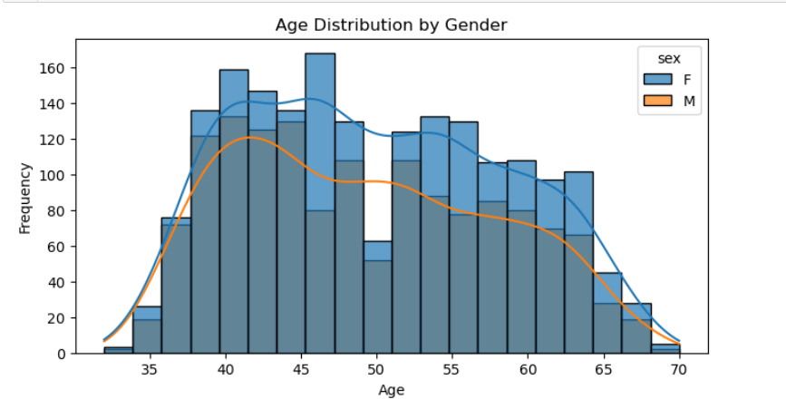
Data VIZ-Gender Distribution:
Females consistently outnumber males across all age groups.
The trend is most pronounced around the age of 45 when the female frequency reaches its peak.
The male frequency starts to decline noticeably after the age of 50
There are more occurrences of females than males in the dataset. This suggests that the dataset may be biased toward Females which might produce results biased toward female

Slide 9
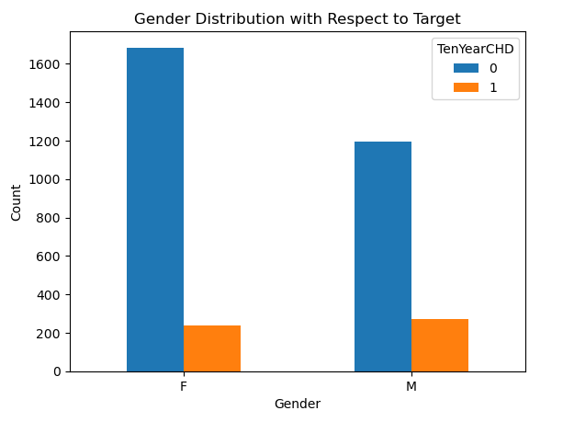
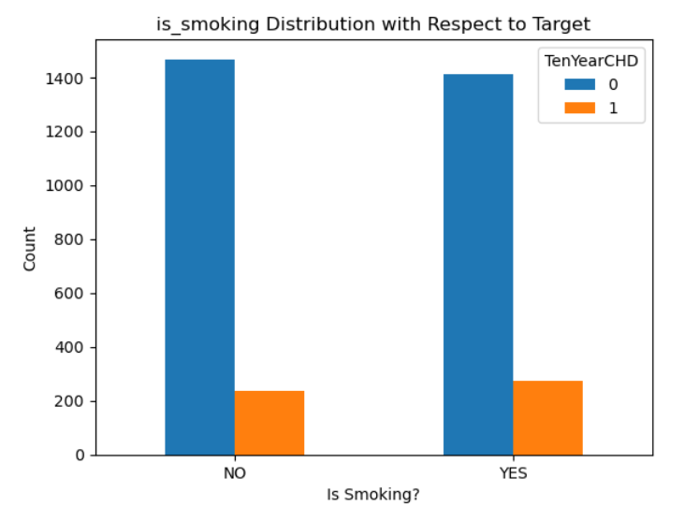
Data Visualization:
More females have no risk and a higher proportion of males face a risk of cardiovascular disease.
It’s essential to monitor risk factors and take preventive measures to maintain heart health.
More non-smokers have no risk of CHD the proportion of smokers with CVD risk is slightly higher than that of non-smokers.
It's crucial to consider Quit smoking and heart-healthy lifestyle choices to reduce cardiovascular risk.

Slide 10
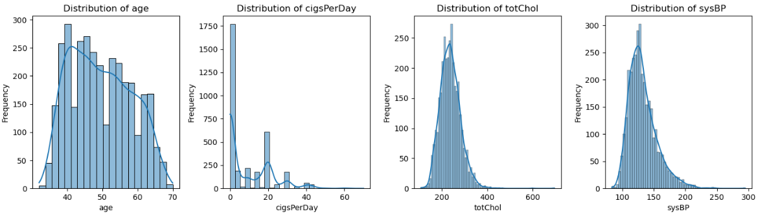
Data Viz(Univariate Analysis):
A majority of the population consists of younger individuals who don’t smoke or smoke minimally, while their total cholesterol levels and systolic blood pressure remain within moderate ranges
All the features are more or less Skewed towards the Right

Slide 11
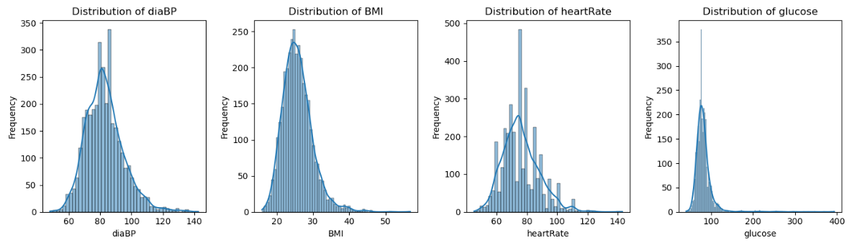
Data Viz(Univariate Analysis):
A majority of the population has diastolic blood pressure around 80, a Body Mass Index (BMI) near 25 (within the healthy weight range), a resting heart rate close to 70, and glucose levels of approximately 100.
All the features are more or less Skewed towards the Right

Slide 12
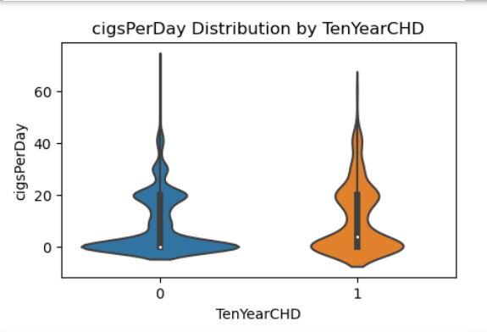
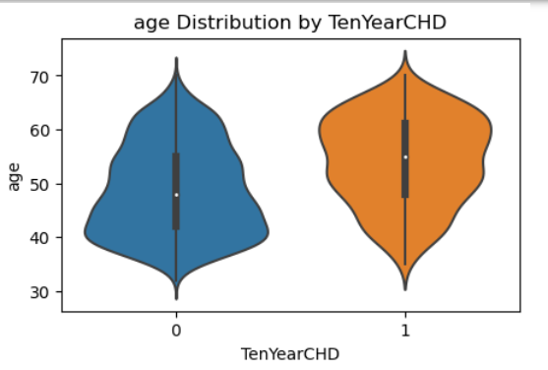
Data Viz(Bivariate Analysis):
Individuals with a TenYearCHD value of 1 tend to smoke more cigarettes than those with a TenYearCHD value of 0. This suggests that smoking is associated with an increased risk of cardiovascular disease in the next decade. 🚬🫀
The risk of CVD is higher for elder patients than younger patients

Slide 13
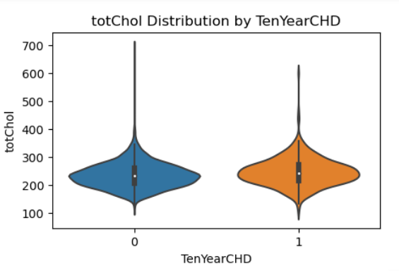
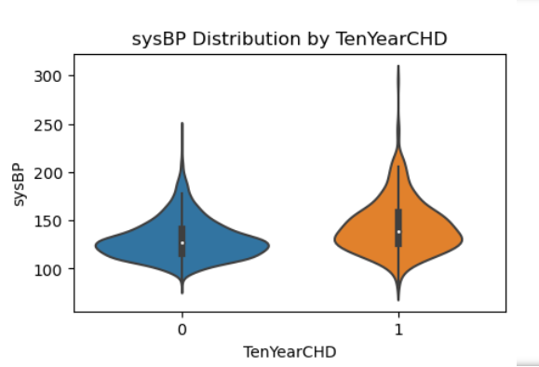
Data Viz(Bivariate Analysis):
The median cholesterol level appears higher in the TenYearCHD = 1 group, indicating a potential association between elevated cholesterol and increased cardiovascular risk.
The higher median sysBP and diaBP in the TenYearCHD = 1 group suggests a potential association between elevated blood pressure and increased cardiovascular risk.

Slide 14
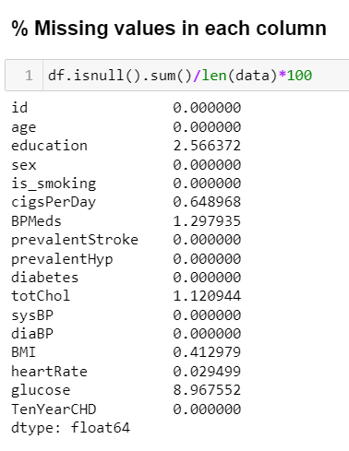
Data Preprocessing:
Missing Value Treatment:
There were a total of 510 missing
values in the dataset.
Total missing values and how they
were handled are as follows:
Education(87) , BP Medication(44) – mode Imputation
Cigarettes per day(22)– imputed with median cigarettes per day for smokers
Total cholesterol(38), BMI(14), Heart rate(1) median imputation.
Glucose(304)- Imputed with Median

Slide 15
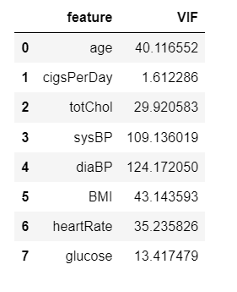
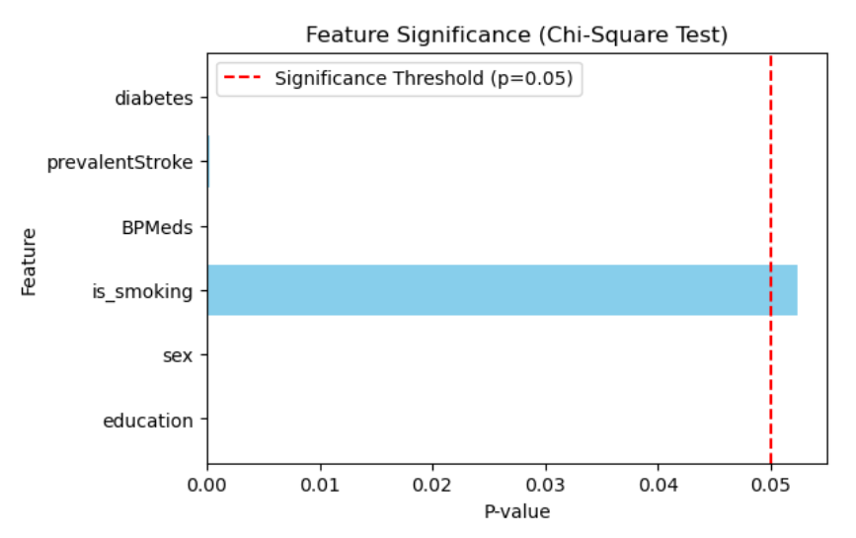
Feature Selection:
The Chi2 test on discrete features indicates that the ‘is_smoking’ column has the highest p-value and so is the least relevant feature. As a result, we drop it.
Detecting Multicollinearity among numerical features using Variance inflation Factor
To handle multicollinearity between sysBP and diaBP, we can replace these two columns with a new variable 'pulse pressure’ Pulse Pressure = Systolic BP - Diastolic BP

Slide 16
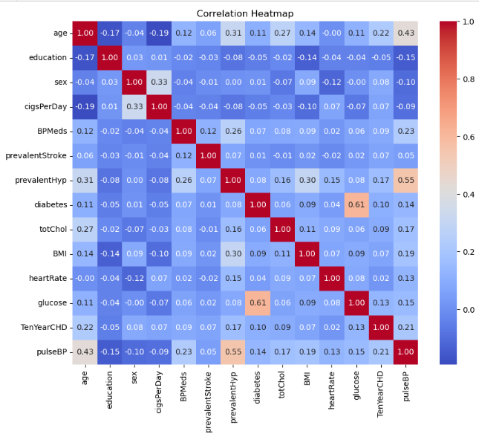
Correlation Matrix:
Glucose and Diabetes: These two features are highly correlated (0.61). This suggests that there might be redundancy between them. Given that glucose is a continuous numerical feature, it might contain more granular information compared to the binary diabetes feature.

Slide 17
Handling Skewness:
The Skewness in the Numerical features was reduced by log transformation
Features | Skew before Transformation | Transformation used | Skew after Transformation
age | 0.225796 | Log10 | -0.020114
cigsPerDay | 1.232049 | Log10 | 0.348739
totChol | 0.948170 | Log10 | 0.008808
BMI | 1.025551 | Log10 | 0.349126
heartRate | 0.676660 | Log10 | 0.159481
glucose | 6.462108 | Log10 | 2.385747
pulseBP | 1.412382 | Log10 | 0.334093

Slide 18
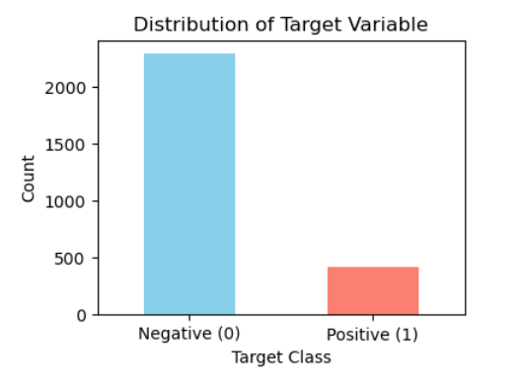

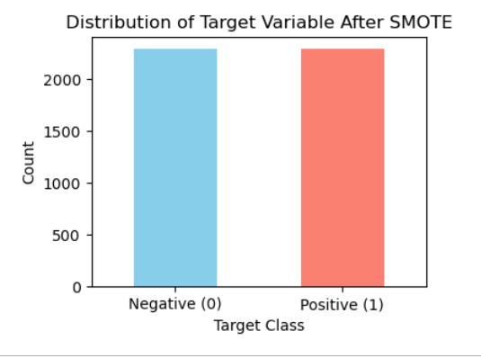
Model Building:
Data was Split using train_test_split with 20% of test size
Training Data was balanced using SMOTE(Synthetic Minority Oversampling Technique)
Standardization was done Using Standard Scaler
Evaluation Metric: Recall_score

Slide 19
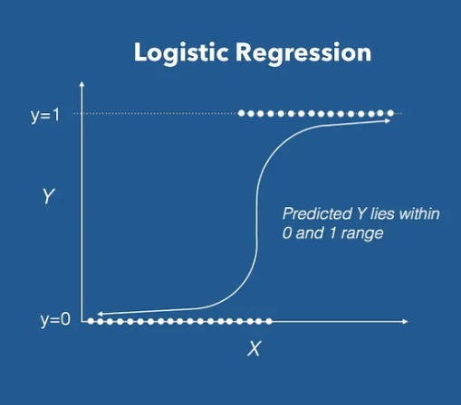

Logistic Regression:
Evaluation Metrics for Logistic Regression:
Train Recall = 69.93%
Test Recall = 64.94%
Test Accuracy = 69.17%
ROC-AUC = 0.735

Slide 20
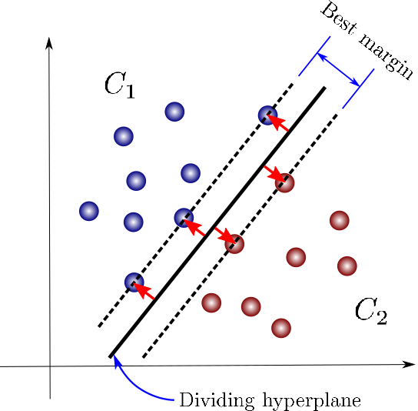

SVM Classifier :
Evaluation Metrics for SVM Classifier:
Train Recall = 69.93%
Test Recall = 64.95%
Test Accuracy = 68.58%
ROC-AUC = 0.673

Slide 21
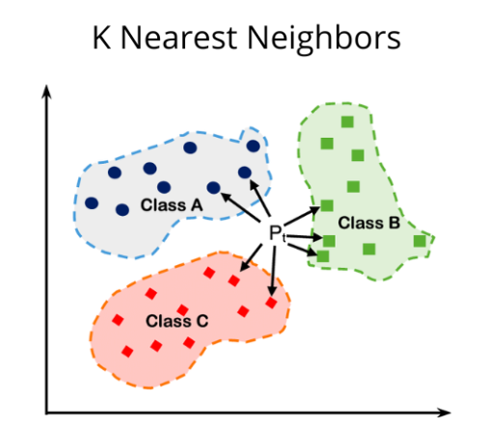

K-Nearest Neighbor Classifier :
Evaluation Metrics for KNN Classifier:
Parameter: k=11
Train Recall = 76.9%
Test Recall = 24.3%
Test Accuracy = 69.46%
ROC-AUC = 0.648

Slide 22
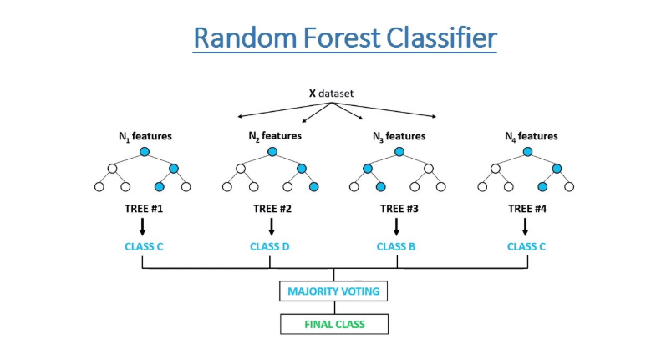

Random Forest Classifier :
Evaluation Metrics for RFC Classifierr:
Train Recall = 79.98%
Test Recall = 62.88%
Test Accuracy = 69.17%
ROC-AUC = 0.723

Slide 23
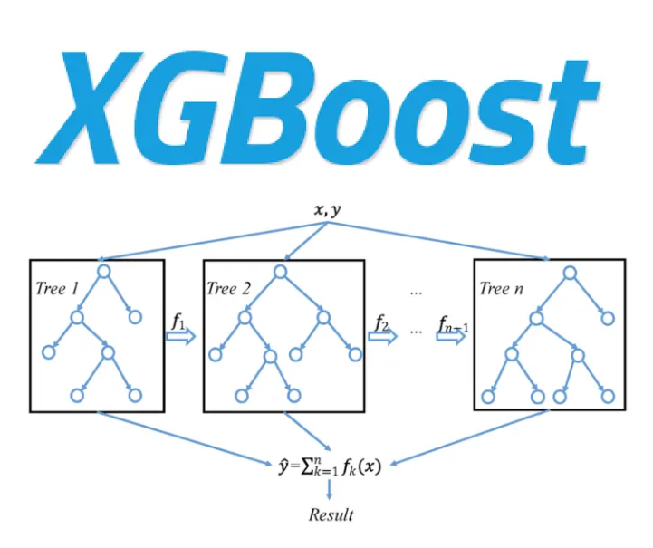
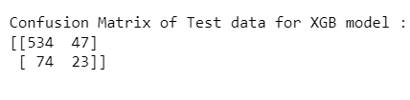
XGBoost Classifier :
Evaluation Metrics for XGB Classifier:
Train Recall = 98.73%
Test Recall = 60.82%
Test Accuracy = 83.3%
ROC-AUC = 0.6759

Slide 24
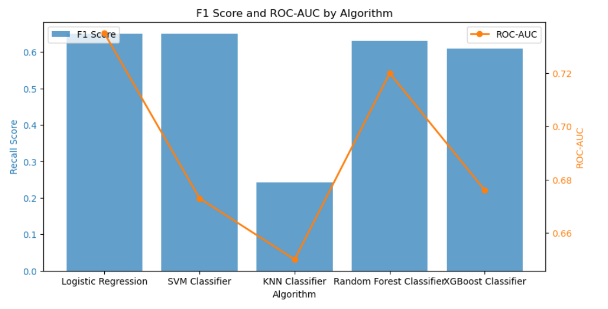
Model Selection:
Logistic Regression and Random Forest classifiers emerge as the top performers for this classification task, with relatively higher recall scores and ROC-AUC values compared to other models

Slide 25
Further recommendation:
Conclusion:
We have successfully built predictive models that can predict a patient’s risk for CHD based on their demography, lifestyle, and medical history.
The predictive models built were evaluated using Recall, and it was found that Logistic Regression(69.17%) and Random Forest(62.88) classifiers have relatively higher recall scores and ROC-AUC values compared to other models
Collect More Data: A larger dataset may help capture more complex patterns and improve the generalization ability of the models especially for patients with CVD.
Hyperparameter Tuning: Fine-tuning the hyperparameters of the models, especially for ensemble methods like Random Forest and XGBoost, could lead to improvements in performance
Neural Networks:Neural networks can capture complex relationships in the data and may yield improved performance

